Slide 1

Welcome to nursery
Young children learn best through playing, interacting and having fun!

Slide 2

Meet the team
Mrs Sprott
Teaching assistant
(Photo to follow)
Miss Walker
Class teacher

Slide 3
Partnership with parents
Starting nursery can be an exciting time for you and your child, however it is also normal to feel anxious and have questions.
We are here to work in partnership with you, recognising and valuing your role as your child’s first and most important educator. We will build positive relationships with you and involve you fully in your child’s learning journey.

Slide 4

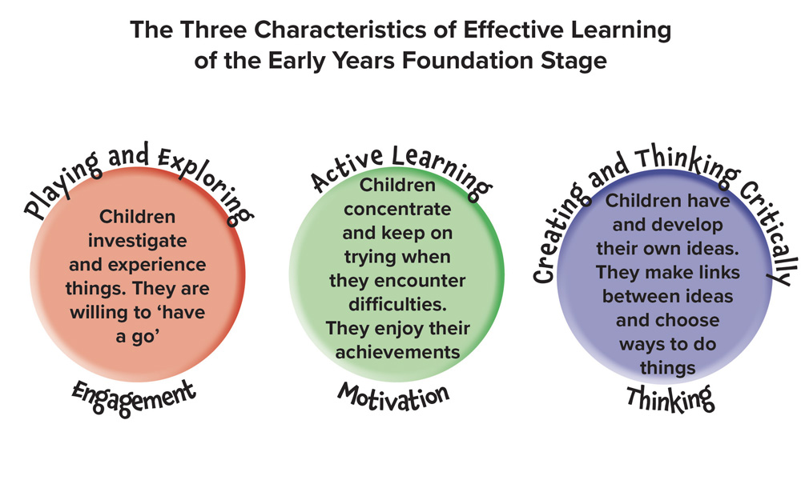
Our curriculum

Slide 5
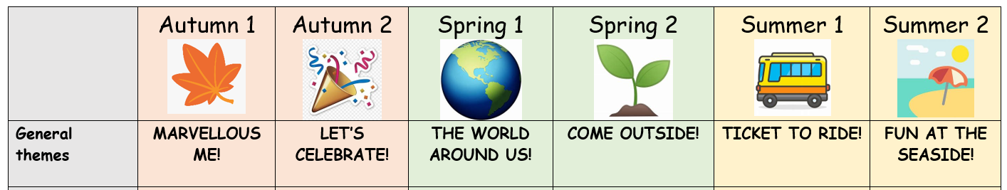
Our curriculum

Slide 6

Our school day
9.00am-3.00pm
Attendance and punctuality are important so please arrive on time
Any illnesses or holidays must be reported to the office
First aid will be communicated through email or telephone if more serious
.

Slide 7
Our Morning Routine
8.30 – 9.00 am – Arrive at school, self registration, exploring.
9.00 am – RWI phonics
9.10am – 10.15 am Exploring
10.30 – Snack and Story
Let’s Explore!
10.45 am - Math's carpet time
10.55 am – Exploring
11.45 am – Singing
12.00 pm - Lunch
.

Slide 8
Our Afternoon Routine
1.00 pm Register and ‘Wake and Shake’
1.10 - Learning Journey/Music/ P.E/ Forest School/Squiggle while you wiggle/Dough Disco
1.25 – Exploring
2.50 pm Story and end of day prayer
3.00 pm Home time

Slide 9
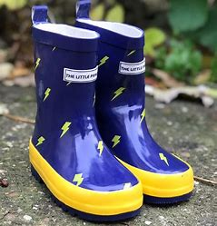
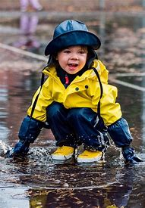
What will your child need?
Learning can be a messy process!
Your child will need:
A full set of clothes on their peg
Waterproof coats in bad weather
Wellies (to be left in school if possible)
.

Slide 10

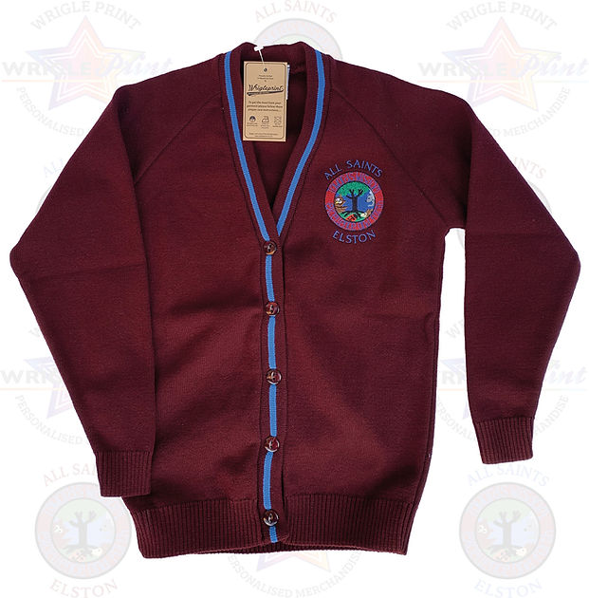

School uniform
The school colours or burgundy, blue and white
School uniform is available to purchase from the office, but can be purchased elsewhere without the logo
Remember to write or stick your child’s name on all of their belongings, including shoes, wellies and coats.
.

Slide 11
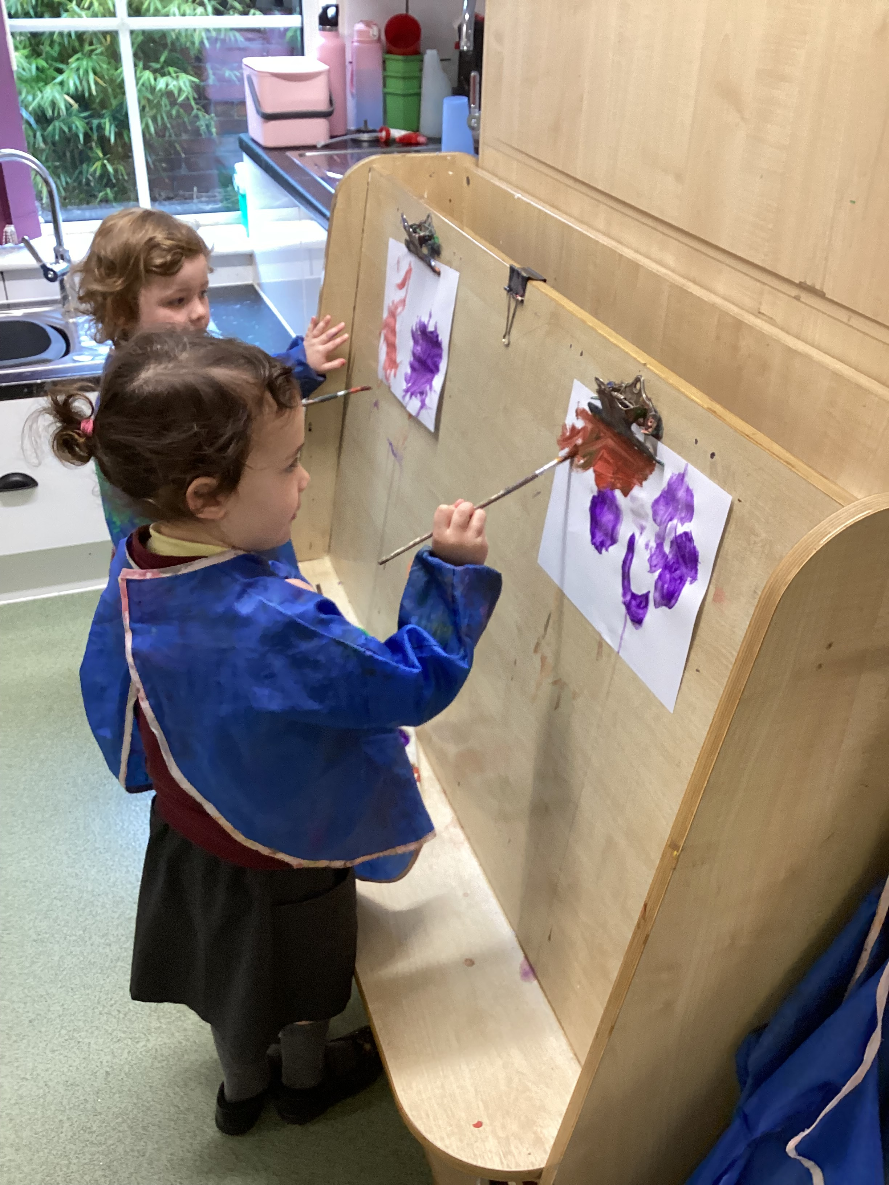
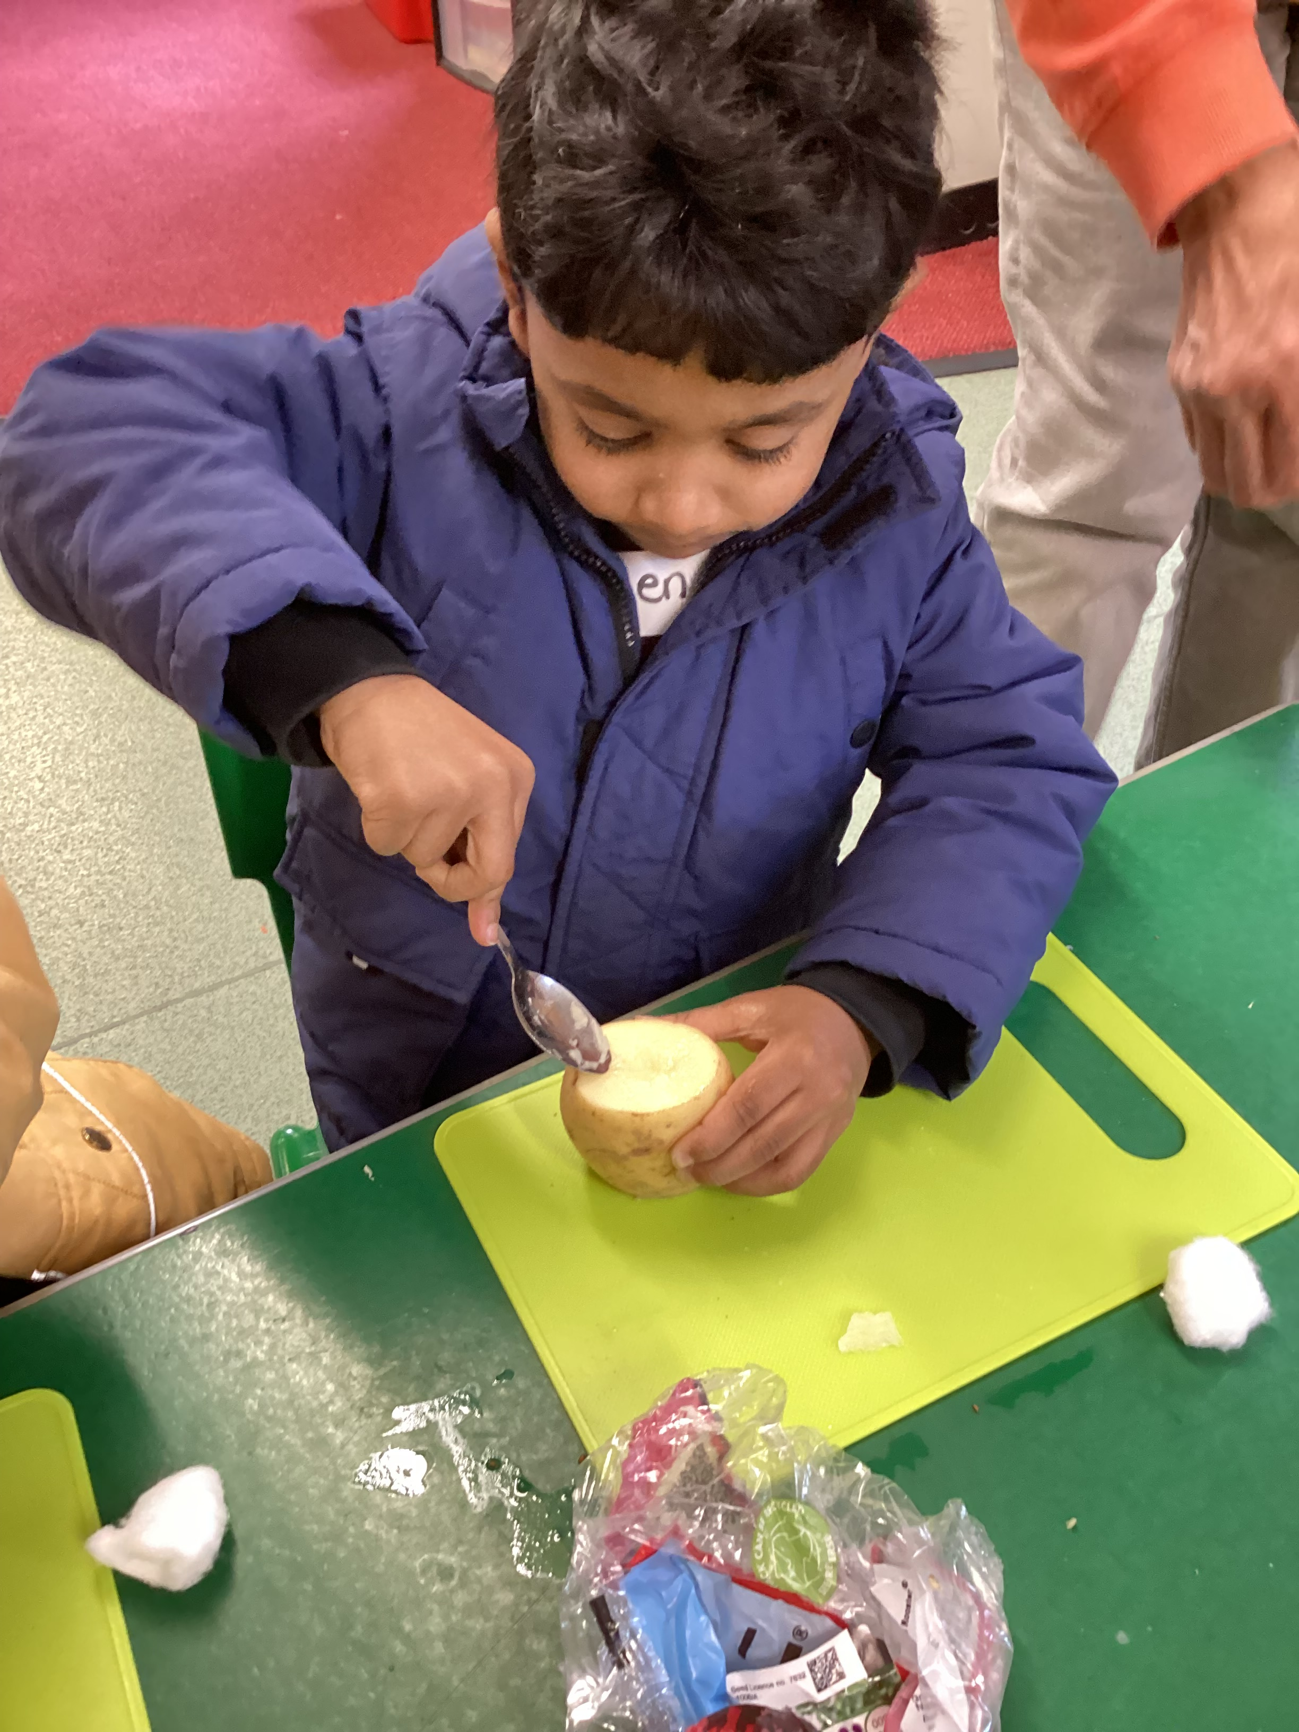
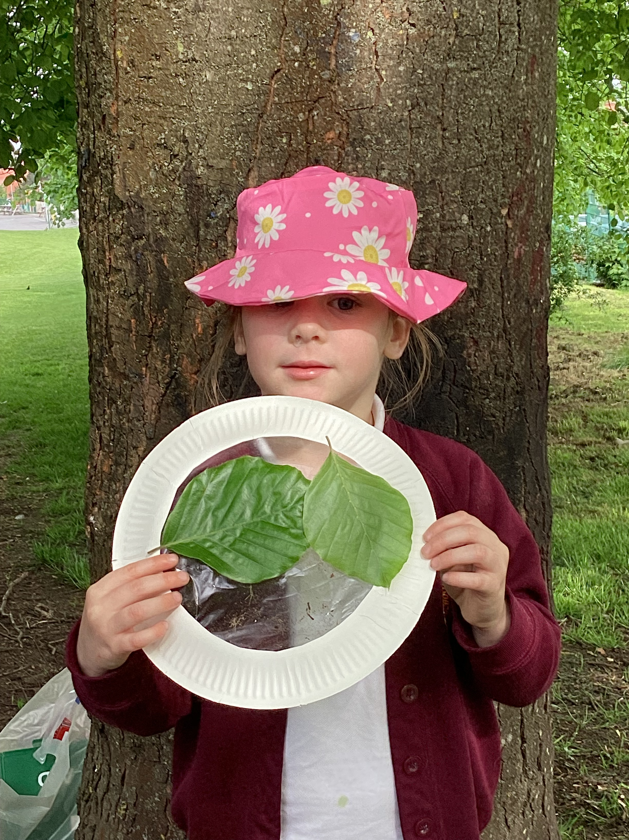
Learning through play
Young children learn best through play
The majority of learning will be child-led rather than adult led.
Staff will:
Support learning by observing play and interacting with the children
Extended children’s interests through questions, suggestions and
adding new resources
.

Slide 12
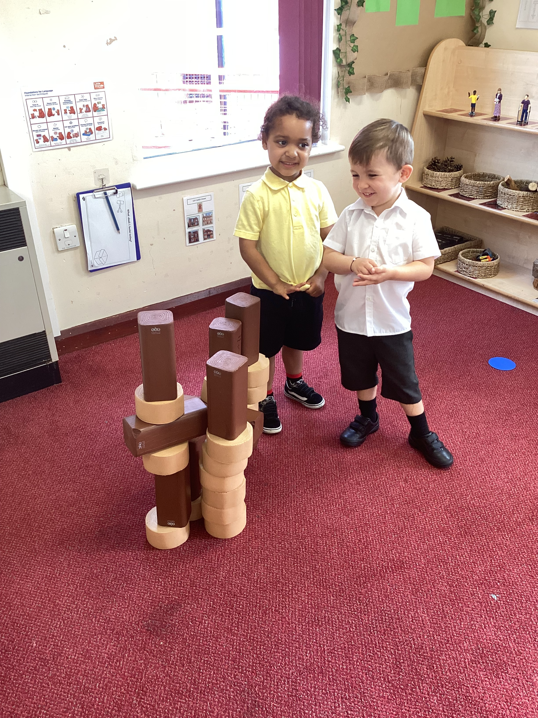
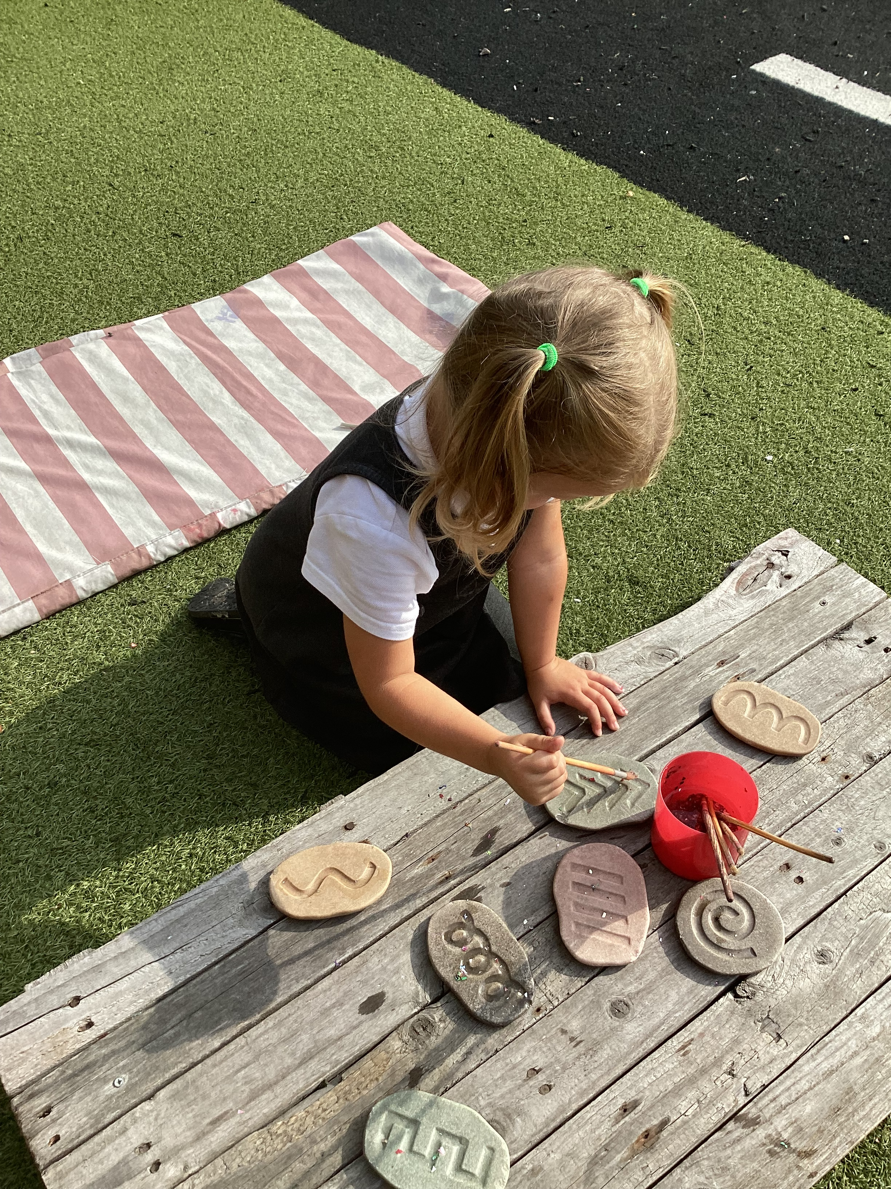
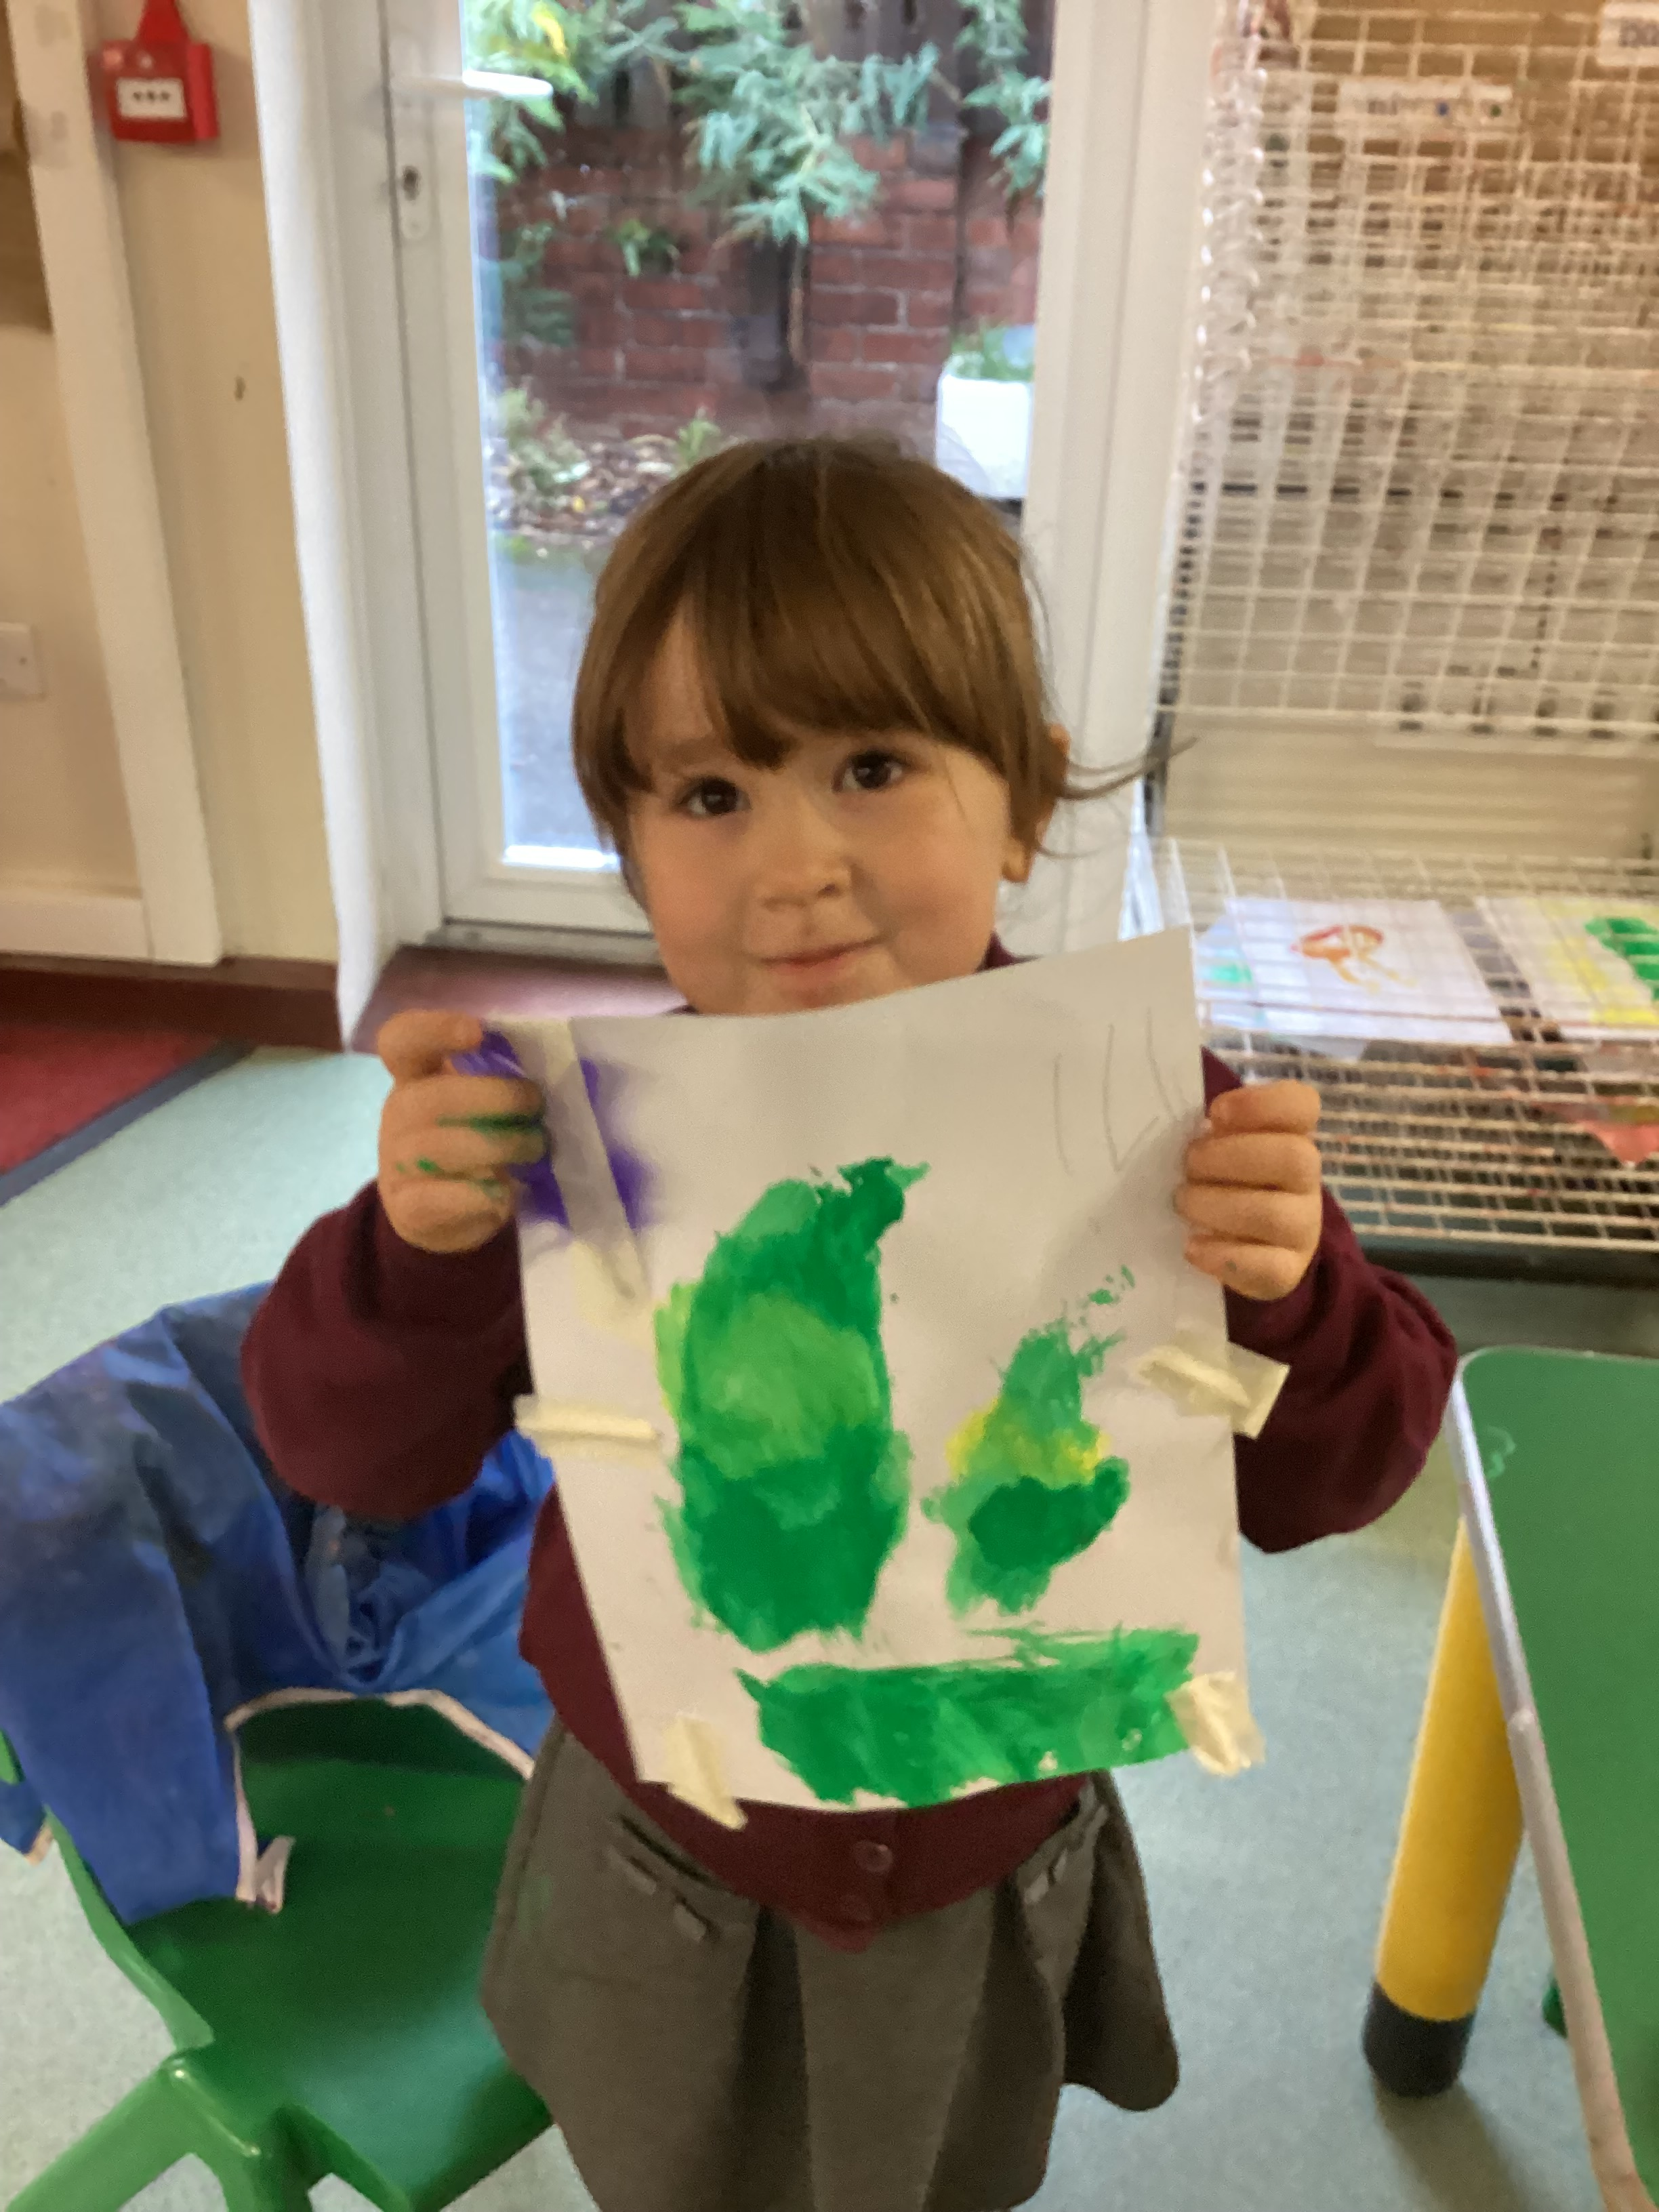
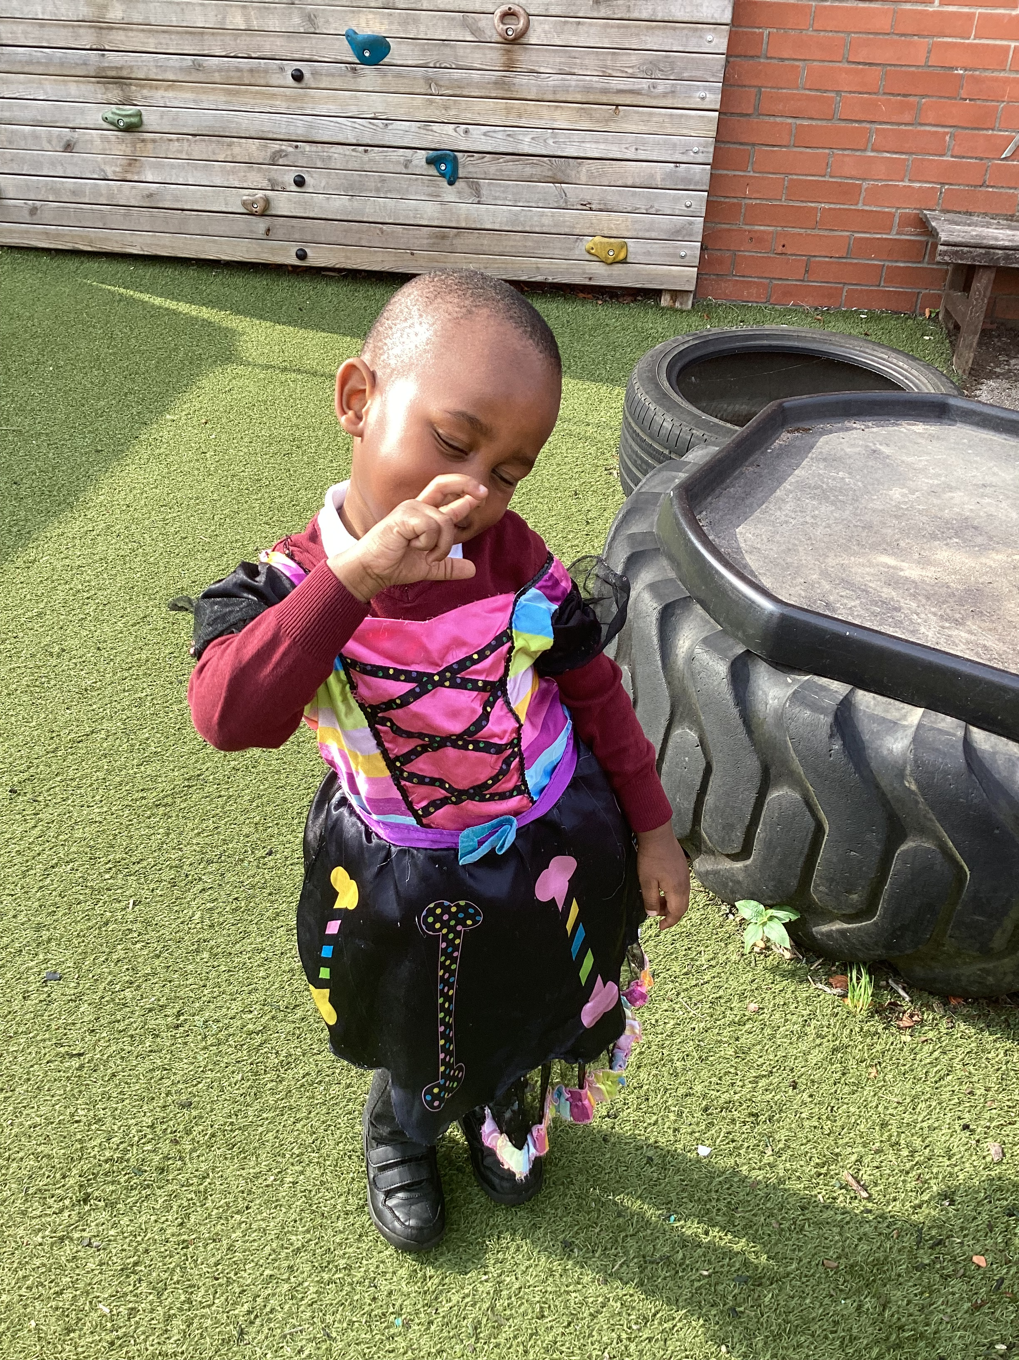
Nursery provision
Areas and resources available:
Mark making area
Maths area
Investigation area and curiosity cube
Home corner and role play
Reading area
Small world and construction
Computing (laptops, technology)
Creative area
Malleable – playdough, cutting
Water and sand play
Outdoor provision
Every child will receive a daily adult-led input of:
Phonics
Maths
Fine/ gross motor activity
Literacy / Understanding the world activity

Slide 13
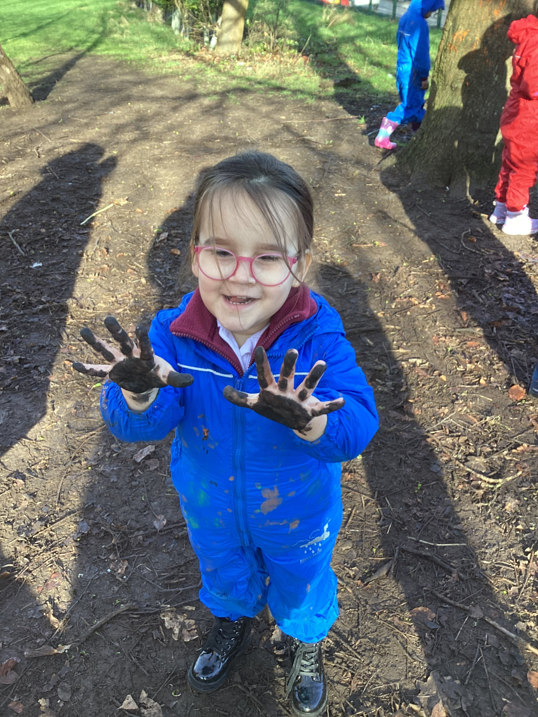
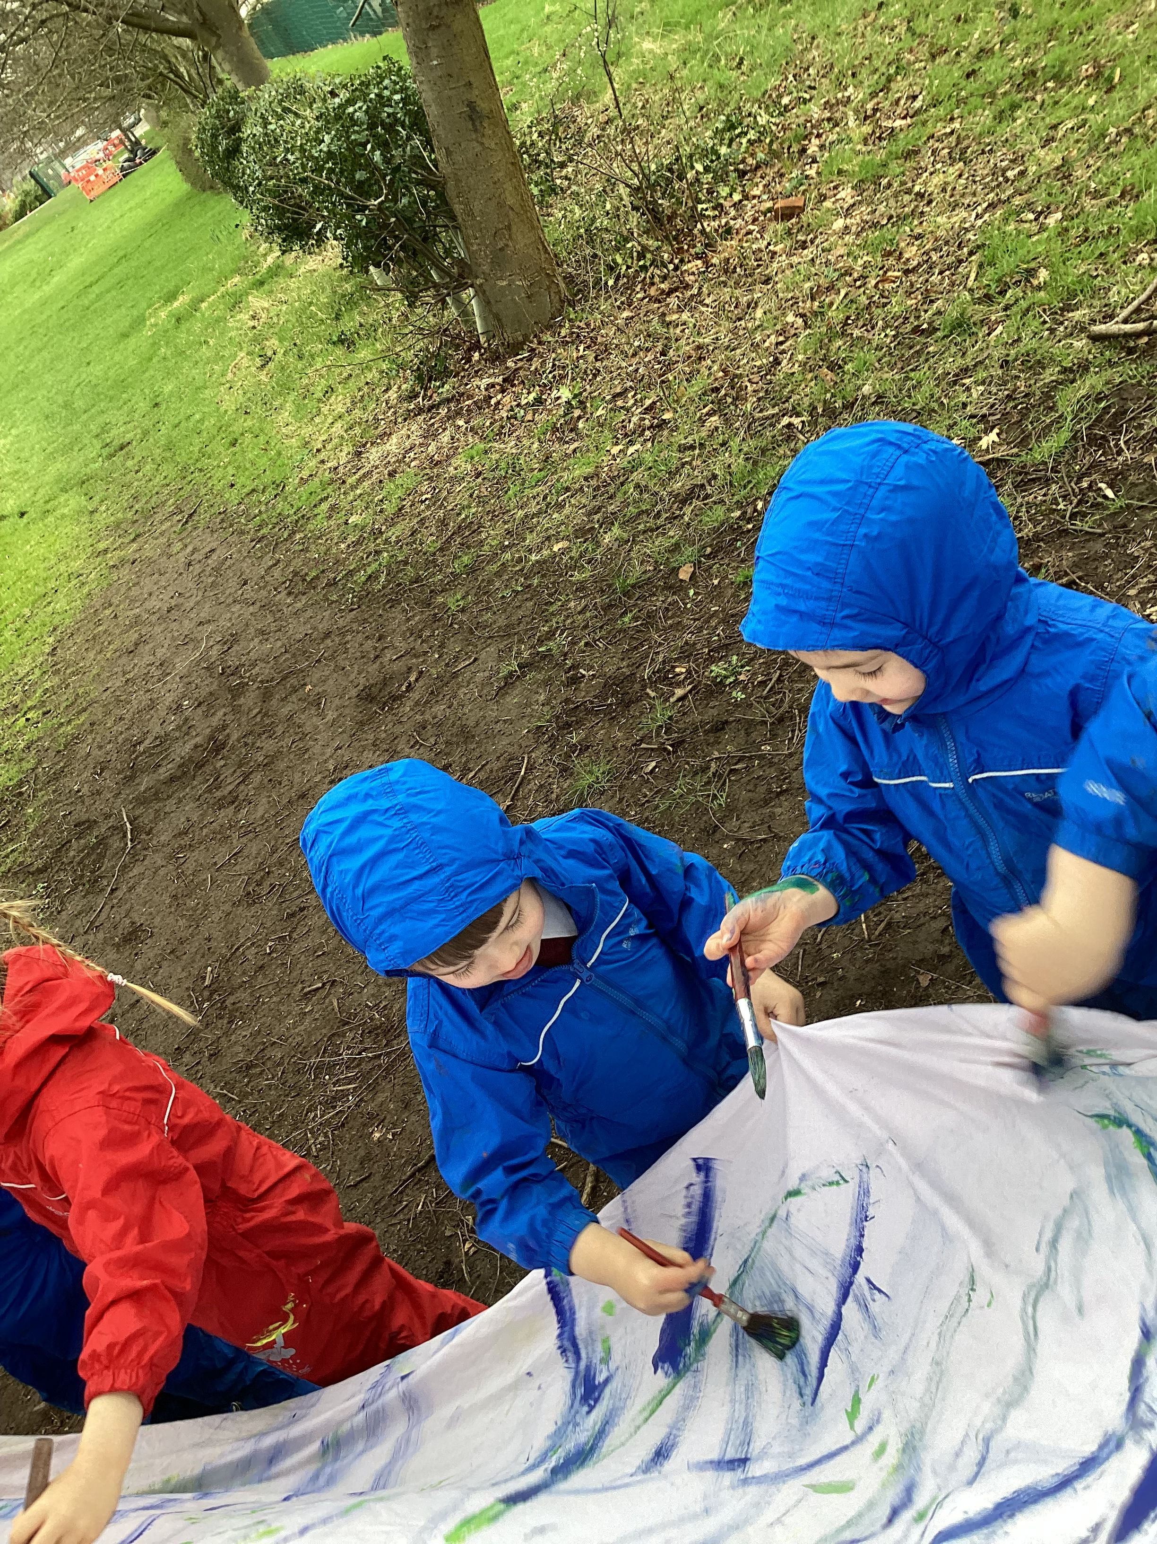
Outdoor learning
Outdoor learning is an important part of nursery provision.
It can:
Improve a child’s physical and mental health
Gross and fine motor skills
Resilience and problem solving skills including risk assessing
Communication skills
Love for nature
FOREST FRIDAY

Slide 14

Children’s independence
We encourage all children to be able to use the toilet independently before beginning their nursery journey
All children should be able to wash their own hands and be independent when drying their hands

Slide 15

Snack and lunch
We will provide a healthy snack for your child each day. This will usually be fruit and milk.
We are a healthy school so please ensure your child’s packed lunch is a healthy one.
Any allergies must be reported to staff
All children should bring a water bottle each day (to be filled with water only)
Children will receive a healthy snack and a carton of milk each day.

Slide 16

Reading
All children will receive a reading wallet with a diary
We recommend you read the same story at least 3 times to develop language

Slide 17
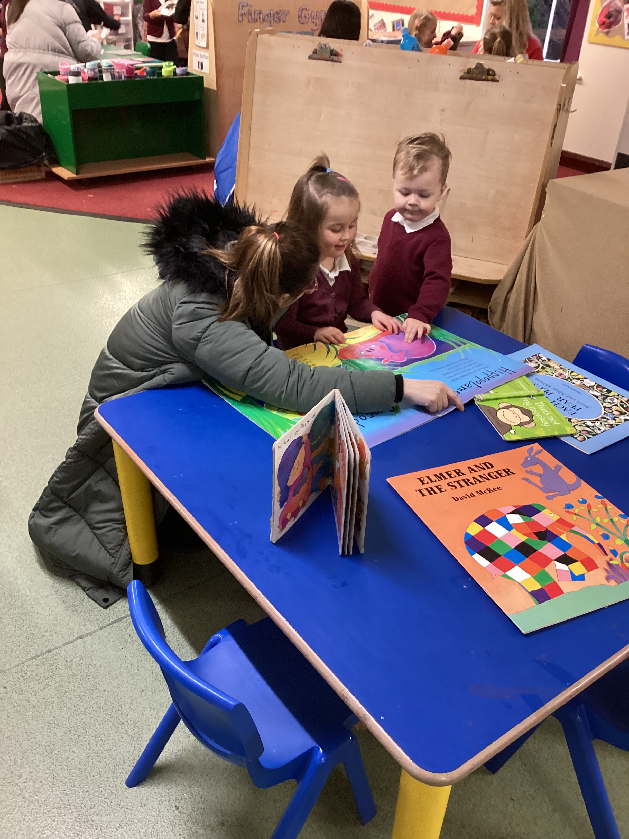
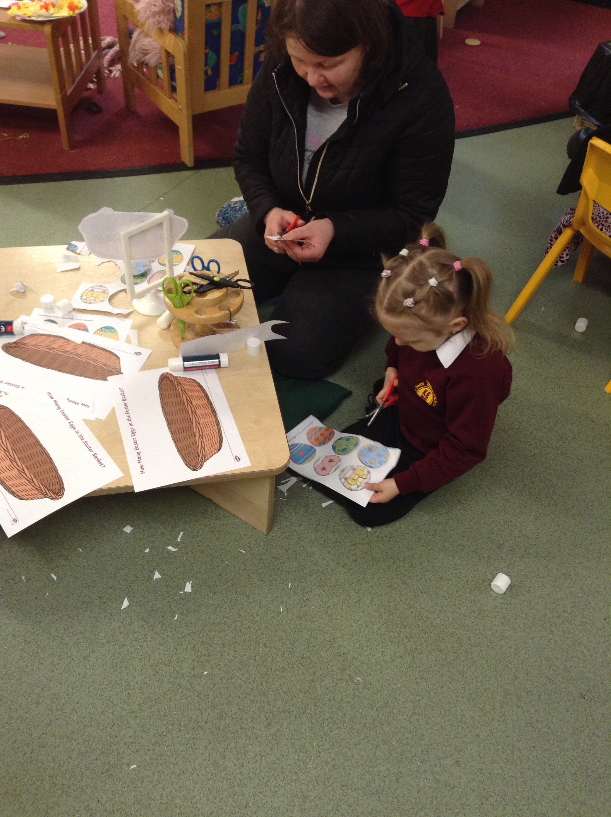
Opportunities for home engagement
Early Bird readers
Thursday 9am – 9:15am
Stay and play
Alternate Fridays 9am – 9.20am
These will run on the Friday the children won’t be doing Forest School.

Slide 18

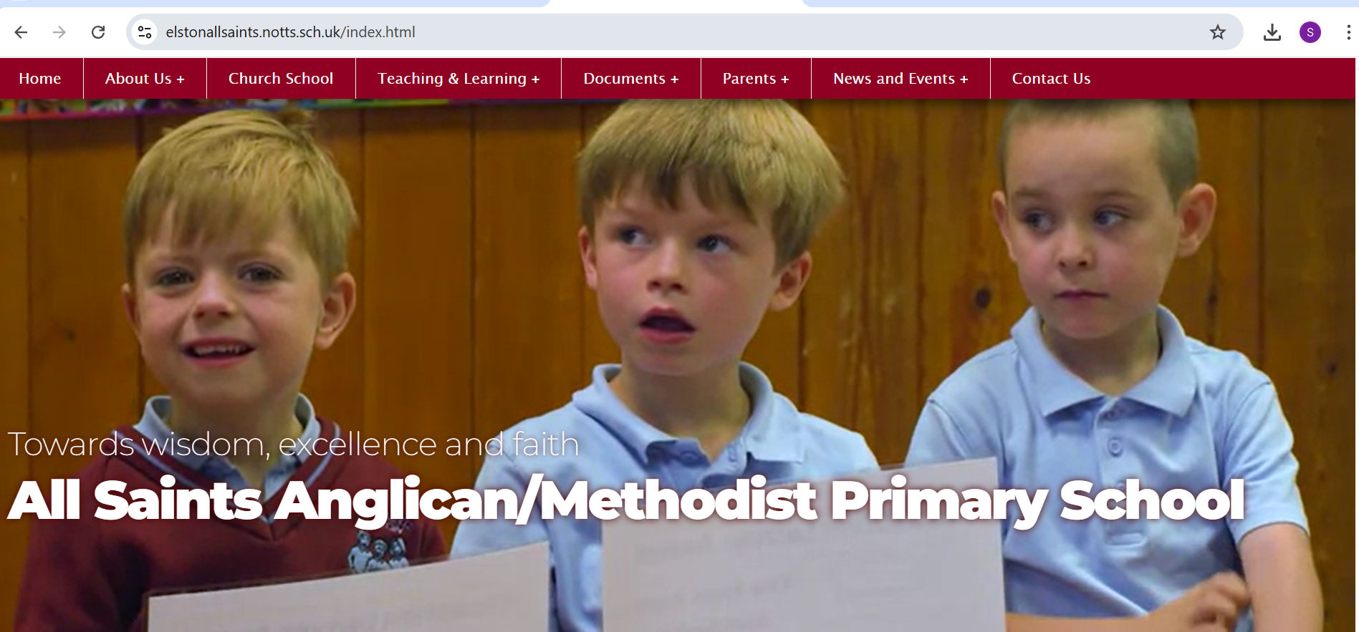
Our learning journey
We love to share our learning journey with you
This will be shown in different ways:
On the school website (updated weekly)
On Tapestry (class story and through pictures)
Class floor book (available at Early Bird Readers and Stay and Play
sessions)

Slide 19
Getting ready for nursery
I can put on my own coat
I can use the toilet
I can recognise my name
I can wash and dry my hands
I can put on my own shoes
I can drink from a water bottle and a carton
I can play with others, share and take turns
I can respond to my name
I can sit and listen to a story
I can join in with nursery rhymes
I can respond to my name

Slide 20
Transition dates
All children are invited to attend a Ready for Nursery session on:
Monday 14th July 1pm – 3pm
Please bring your child to the Nursery entrance for 1pm where they can get to know me and their new friends.
At 3pm you can collect them from the Nursery.
If your child needs additional settling in sessions, the staff will discuss this with you.

Slide 21
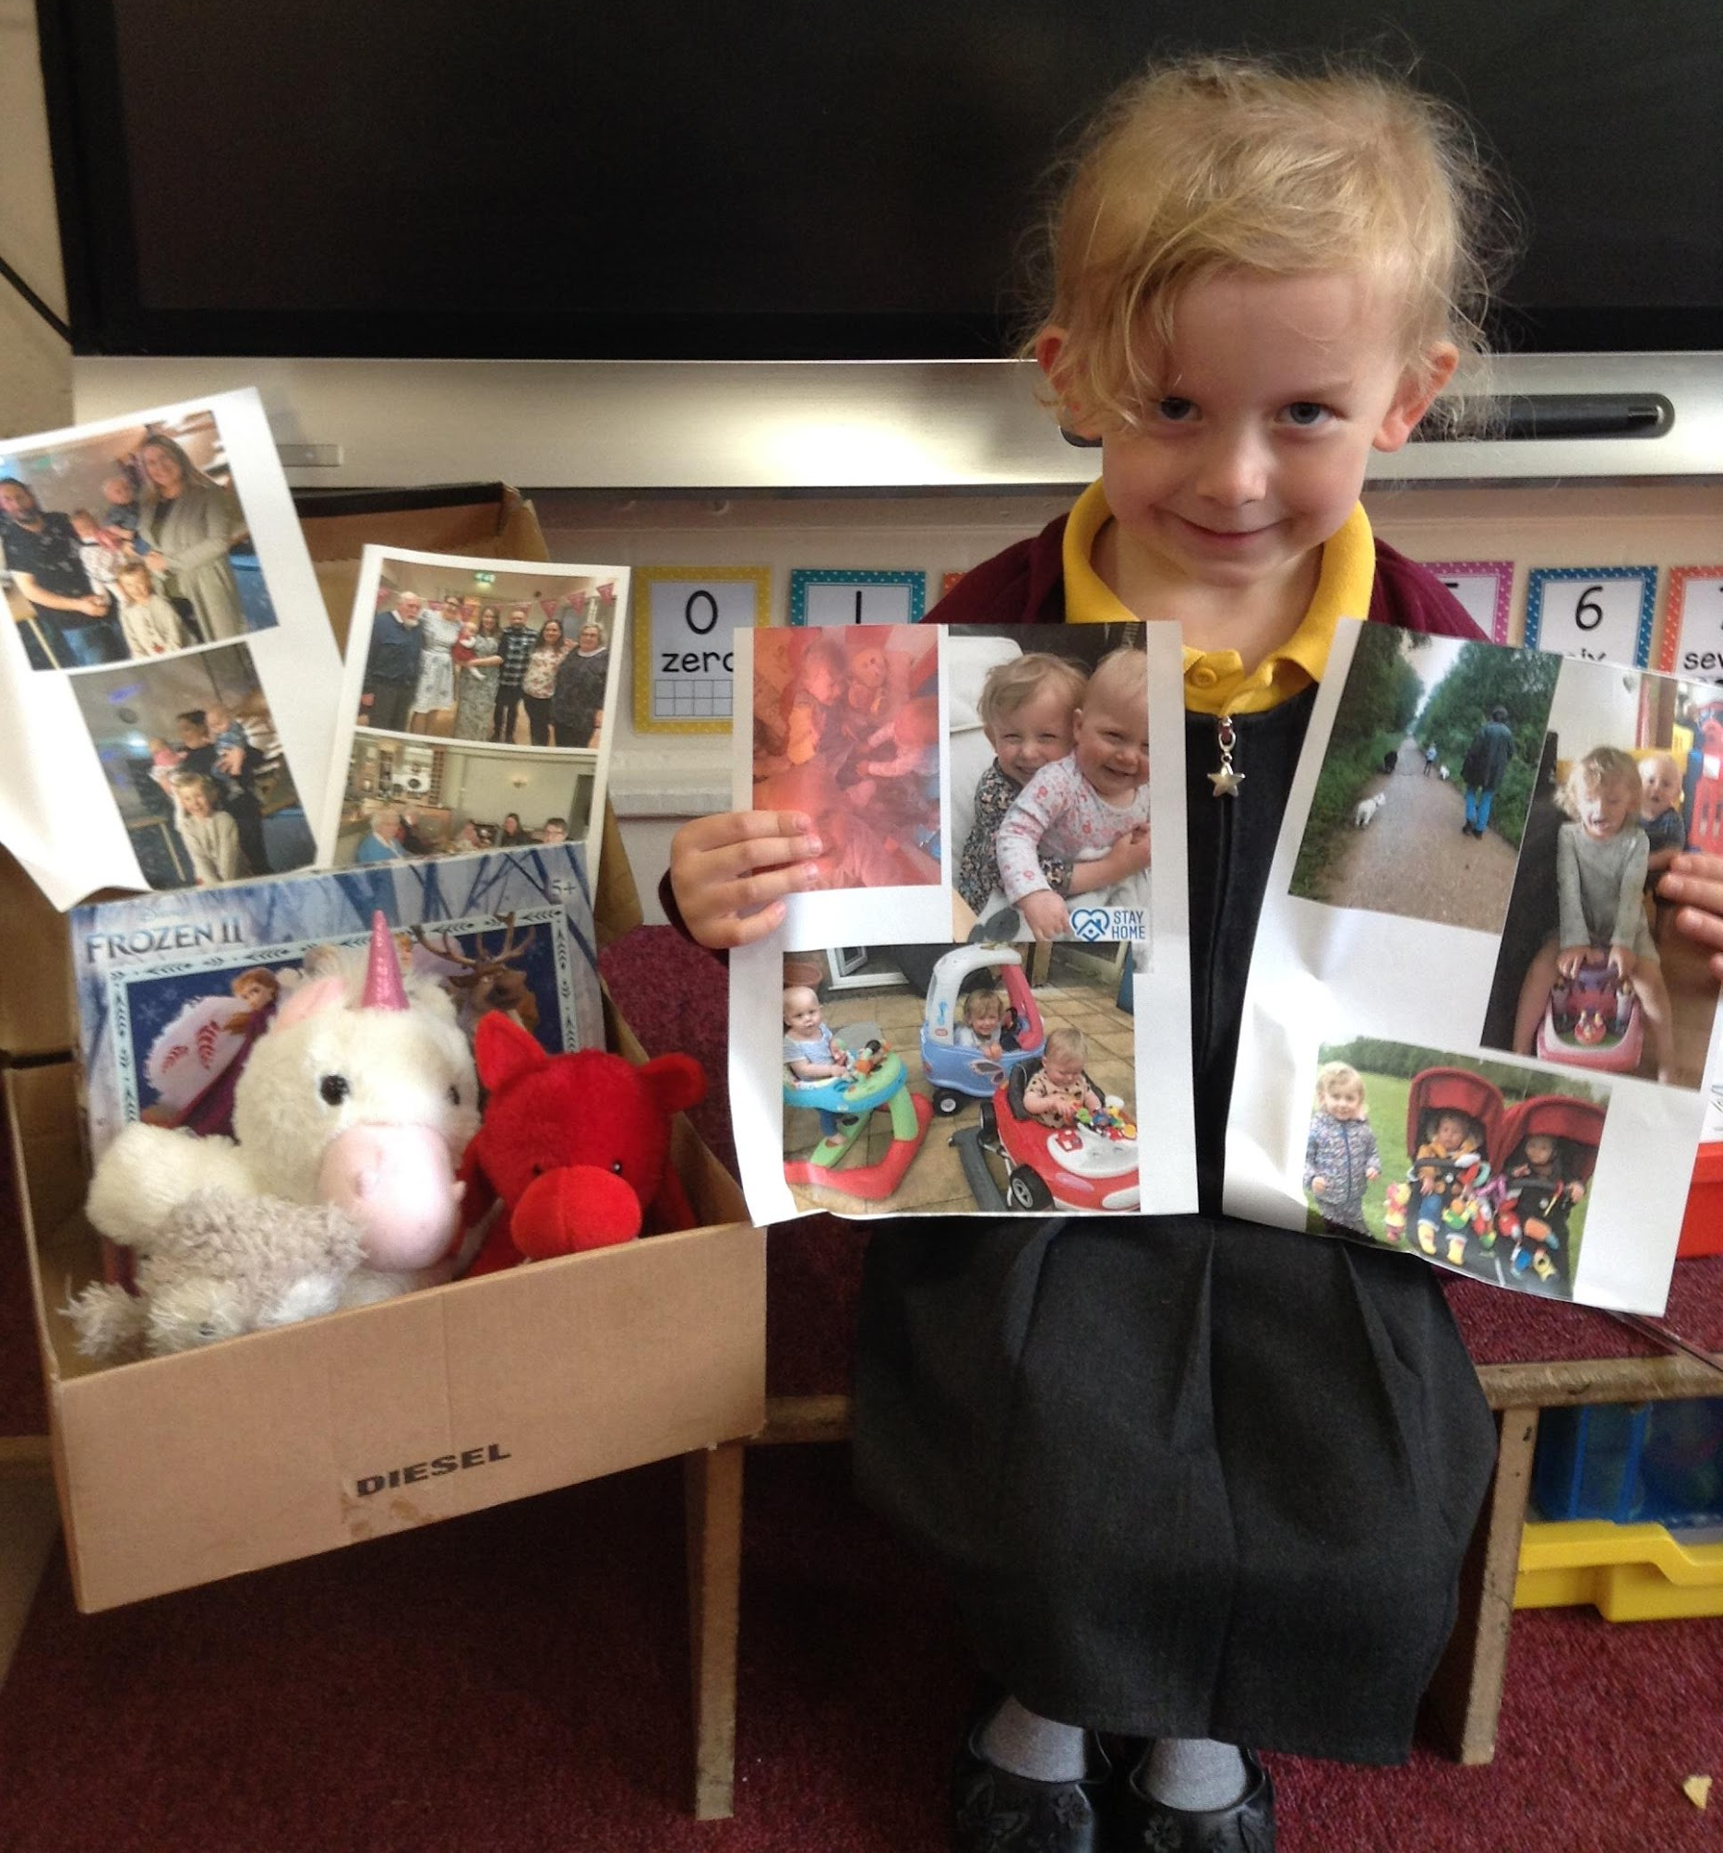
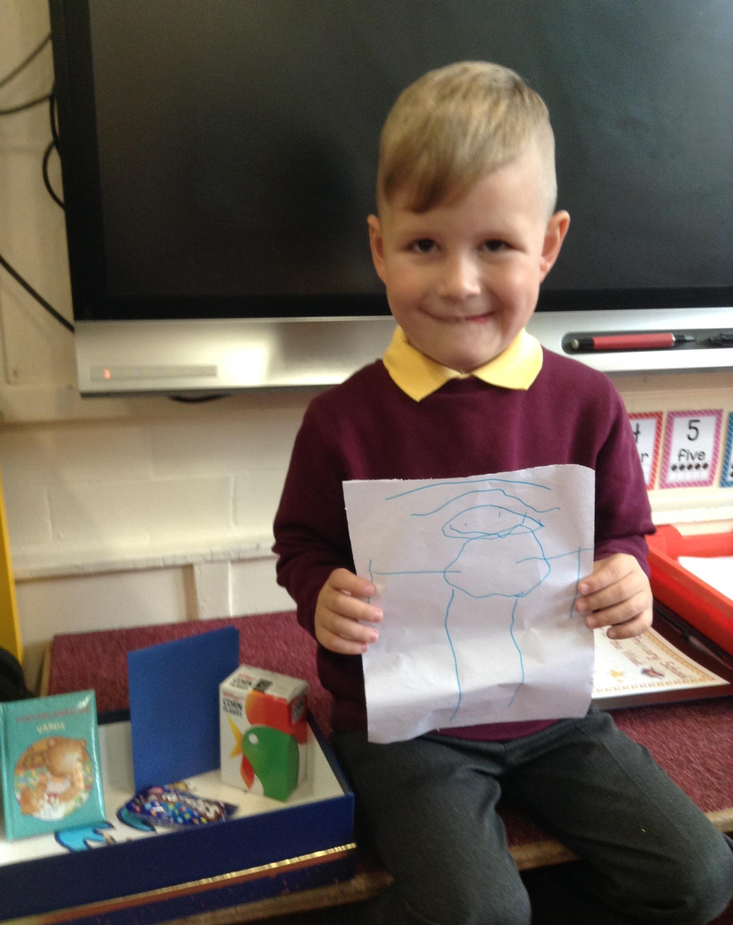
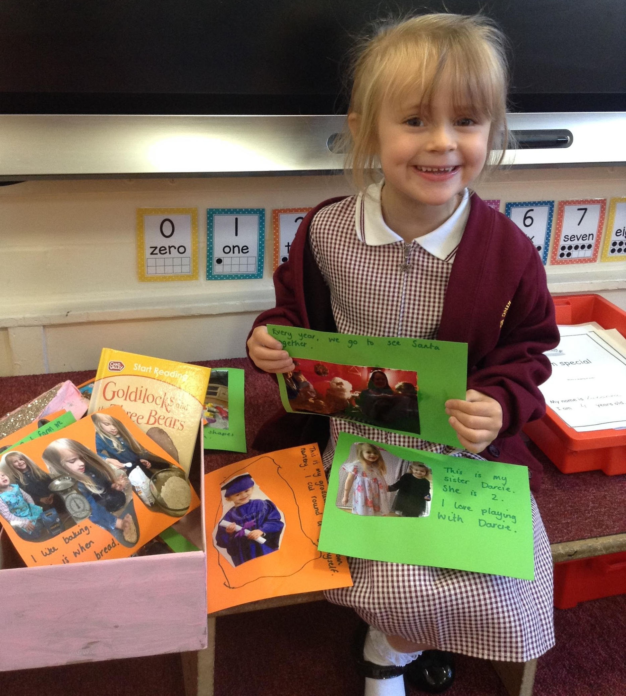
Chatterboxes
A chatterbox is a box, a shoe box is adequate, which contains surprise items.
They are put together to encourage children to talk. Children often want to talk about things that they have already had experiences about and know about therefore it is important to link the contents to children’s interests and previous experiences/successes.
We think this will be a great way for your child to introduce themselves in their new class and for us to get to know them from day one.

Slide 22

THANK YOU!
We look forward to working in a partnership with you, to provide the best start to your child’s learning and Elston All Saints.
We offer an open-door policy so please don’t
hesitate to come and see us.

